Slide 1
SMART TOKEN LABELLING AND TRACEBILITY FOR CYBERSECURITY TOKEN JNN INSTITUTE OF ENGINEERING
DEPARTMENT TEAM MEMBERS
CSE(cyber security) Vishnupriya.v
Monishree.P
Sandhiya.M
Prasana.N
Keshini.A

Slide 2
What is Traceability?
Traceability refers to the ability to track the history, application, or location of a product throughout its lifecycle.
What is Labelling?
Labelling involves assigning a unique identity (like a QR code or barcode) to each product for identification.

Slide 3
Purpose of this project:
To build a system that allows users to label a product with a QR code and trace its details by scanning it, helping improve transparency and product tracking.
Cyber tokens may be duplicated or misused without secure tracking.
Lack of traceability may lead to trust and security issues.
Manual handling or poor record-keeping increases risk.
Need for a system that labels each token uniquely and stores usage records.

Slide 4
Objectives
secure database.
Provide a scanning mechanism to trace token details. Generate unique QR codes for each cyber token.
Store token data (name, ID, issue date) in a
Enable efficient logging and monitoring of token activity

Slide 5
Components:
User Interface for data input QR code.
generator module SQLite database for
storing token
Info Scanner module for traceability

Slide 6
Technologies
Used Python – Development language VS Code – IDE usedSQLite3 – Lightweight database for storing token details Qr code library – Generates QR codes
Flask (if used) – Web interface for scanning or viewing tokens Pillow – For handling image files

Slide 7
Workflow of the System
User enters token name and ID.
System generates a unique QR code.
Token data + QR code are saved to the database.
QR code can be scanned to fetch token details.
Logs can be updated (optional) on each scan/use

Slide 8
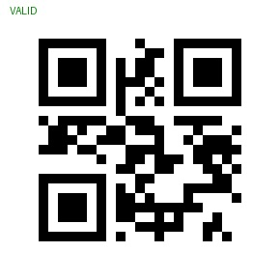
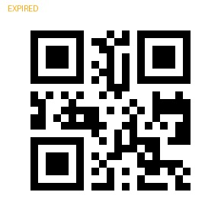
QR Code Generation Uses
Python’s Qrcode library.
Encodes token metadata into QR format.
Output is a .Png image stored locally.
Example QR data:CYBER101-AUTH-TOKEN-11/07/2025 10:00AM

Slide 9
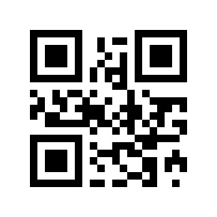
Traceability Process
When QR code is scanned:
Encoded string is decoded.
Application checks for matching entry in the database.
Displays token name, ID, issue date, and other metadata.

Slide 10
Thank you!

